Slide 1
MOESC Administration Day
August 2, 2021

Slide 2
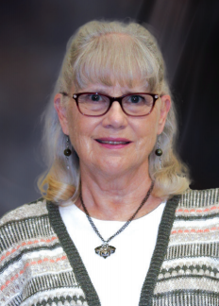
Behavior Support Team Presentation
Jennifer Crum Director of
Student Services
Cathy Csanyi Educational
Consultant
PBIS
Ang Fetter
Special Education Consultant
BCaBA
Ann Pfister
Educational
Consultant
Trauma & Resiliency
Notes:
Each presenter introduces themselves
Today, we are going to address several items as each relate to one very simple word: BEHAVIOR! Our agenda includes...
Refreshing your understanding of Each Child, One Future…. Specifically the Social Emotional Learning Domain and the strategy of meeting the needs of the Whole Child
A consideration of the impact of the last several years...especially the impact of the pandemic
A provision of supports, regarding your responsibility, to address BEHAVIOR, from a COMPLIANCE AND/OR COMMITMENT perspective.
But first, let’s get your opinion… next slide

Slide 5
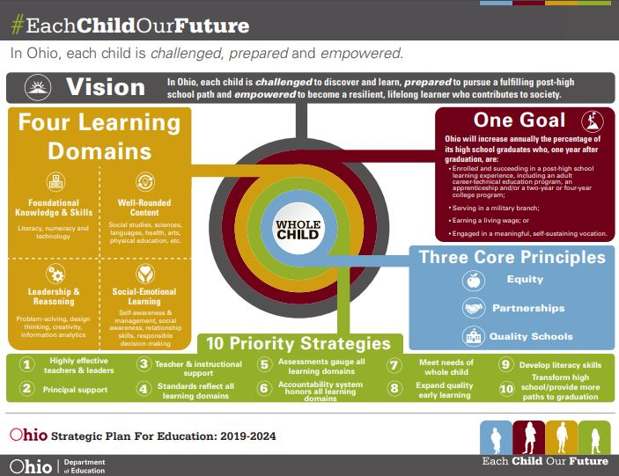
Notes:
In the summer of 2017, the State Superintendent launched Each Child, Our Future, Ohio’s shared strategic plan.
This plan was built by Ohioans for Ohioans.
As you can see, the whole child is at the center of the plan.
The state-level vision provides an aspirational guide for students, parents, partners and the education system.
One goal represents the state’s annual target.
Three core principles, four learning domains and 10 priority strategies work together to support the whole child and enable the state-level vision and goal.
Sae Board of Education.
This 2017 plan was needed for several compelling reasons. Reasons that align with the observations and needs you identified today…
Increased student exposure to poverty and social stressors
Opioid abuse
Homelessness
Increasing child foster care placements
There is no question that issues at home significantly impact a child in the classroom. OUR FOCUS TODAY WILL LIE IN THE SOCIAL EMOTIONAL LEARNING DOMAIN.

Slide 6
And then THIS happened...
Notes:
For most educators, the transition to virtual instruction amidst school closures was a completely new experience and one that caused a lot of stress.
As the 2020-21 school year began, that stress was compounded by pressure to return to the classroom before many educators felt it was safe to do so.
The effects of the pandemic on educators’ professional lives have been exacerbated by the stress and trauma they experience in their personal lives. And, educators have not been exempt from losing loved ones and colleagues to COVID-19.
Black people in the United States were also experiencing trauma from the murders of George Floyd, Breonna Taylor, Ahmaud Arbery, and others. Asian American and Pacific Islander (AAPI) educators have confronted a rise in hate crimes throughout the pandemic.
Providing SEL supports for educators has been shown to benefit students and school communities. Research by Pennsylvania State University found that teachers who developed their SEL skills improved both their own well-being and the social, emotional, and academic development of their students.
On the other hand, research from the Yale Center for Emotional Intelligence found that teachers who were required to teach SEL without being provided professional opportunities to develop their own SEL skills worsened the skills of their students. This is especially important given that research has shown that SEL improves students’ academic achievement by an average of 11 percentile points; helps students develop skills in self-awareness, self-management, social awareness, relationship skills, and responsible decision-making.
Providing educators with SEL supports results in lower levels of stress among the workforce, improved employee attendance, increased ability to model positive emotions for students, and lower levels of turnover.
As school districts look to recover from the pandemic, investing in the SEL skills of their workforces will be essential.

Slide 7
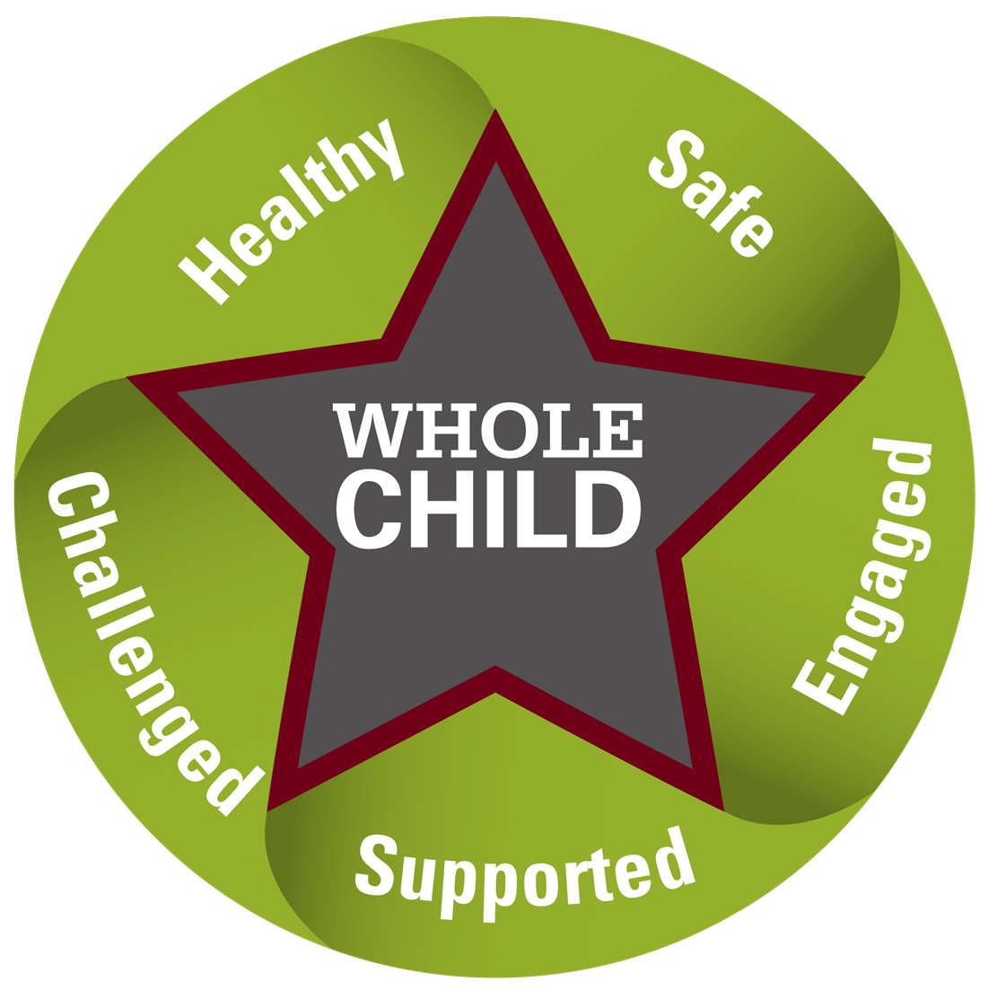
Each Child Means Each Child
Each child is challenged, prepared and empowered!
Every student will be invited, welcomed and given a sense of belonging in a system of teaching and learning that is fluid, responsive and dynamic and that uses all resources matched to each student’s needs.
(McCart & Miller. 2020)

Slide 8
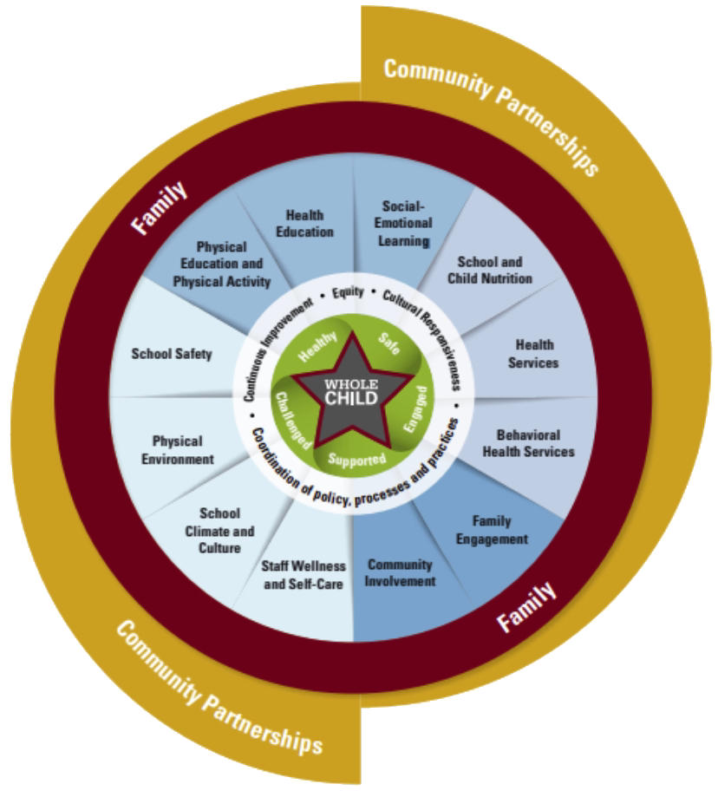
Multi-Tiered Systems of Support
OPTION 1 of 3
Notes:
Guiding Principles MTSS is guided by the following principles:
• A collective responsibility for ensuring growth and success for all learners is assumed by each person within the system (educators, learners, families, and community)
• A proactive approach to ensuring that each and every learner experiences a quality education designed to expand learners' potenti
• A commitment to use data as a basis for information gathering and decision-making to avoid making assumptions
• Attention to fidelity of implementation, honoring both qualitative and quantitative measures
• An investment in systems to promote durability and the scaling up of MTSS
• A commitment to use a systematic problem-solving process to improve outcomes of all learners
• A commitment to ongoing, effective support for educators and leaders including professional learning, feedback, and coaching

Slide 9
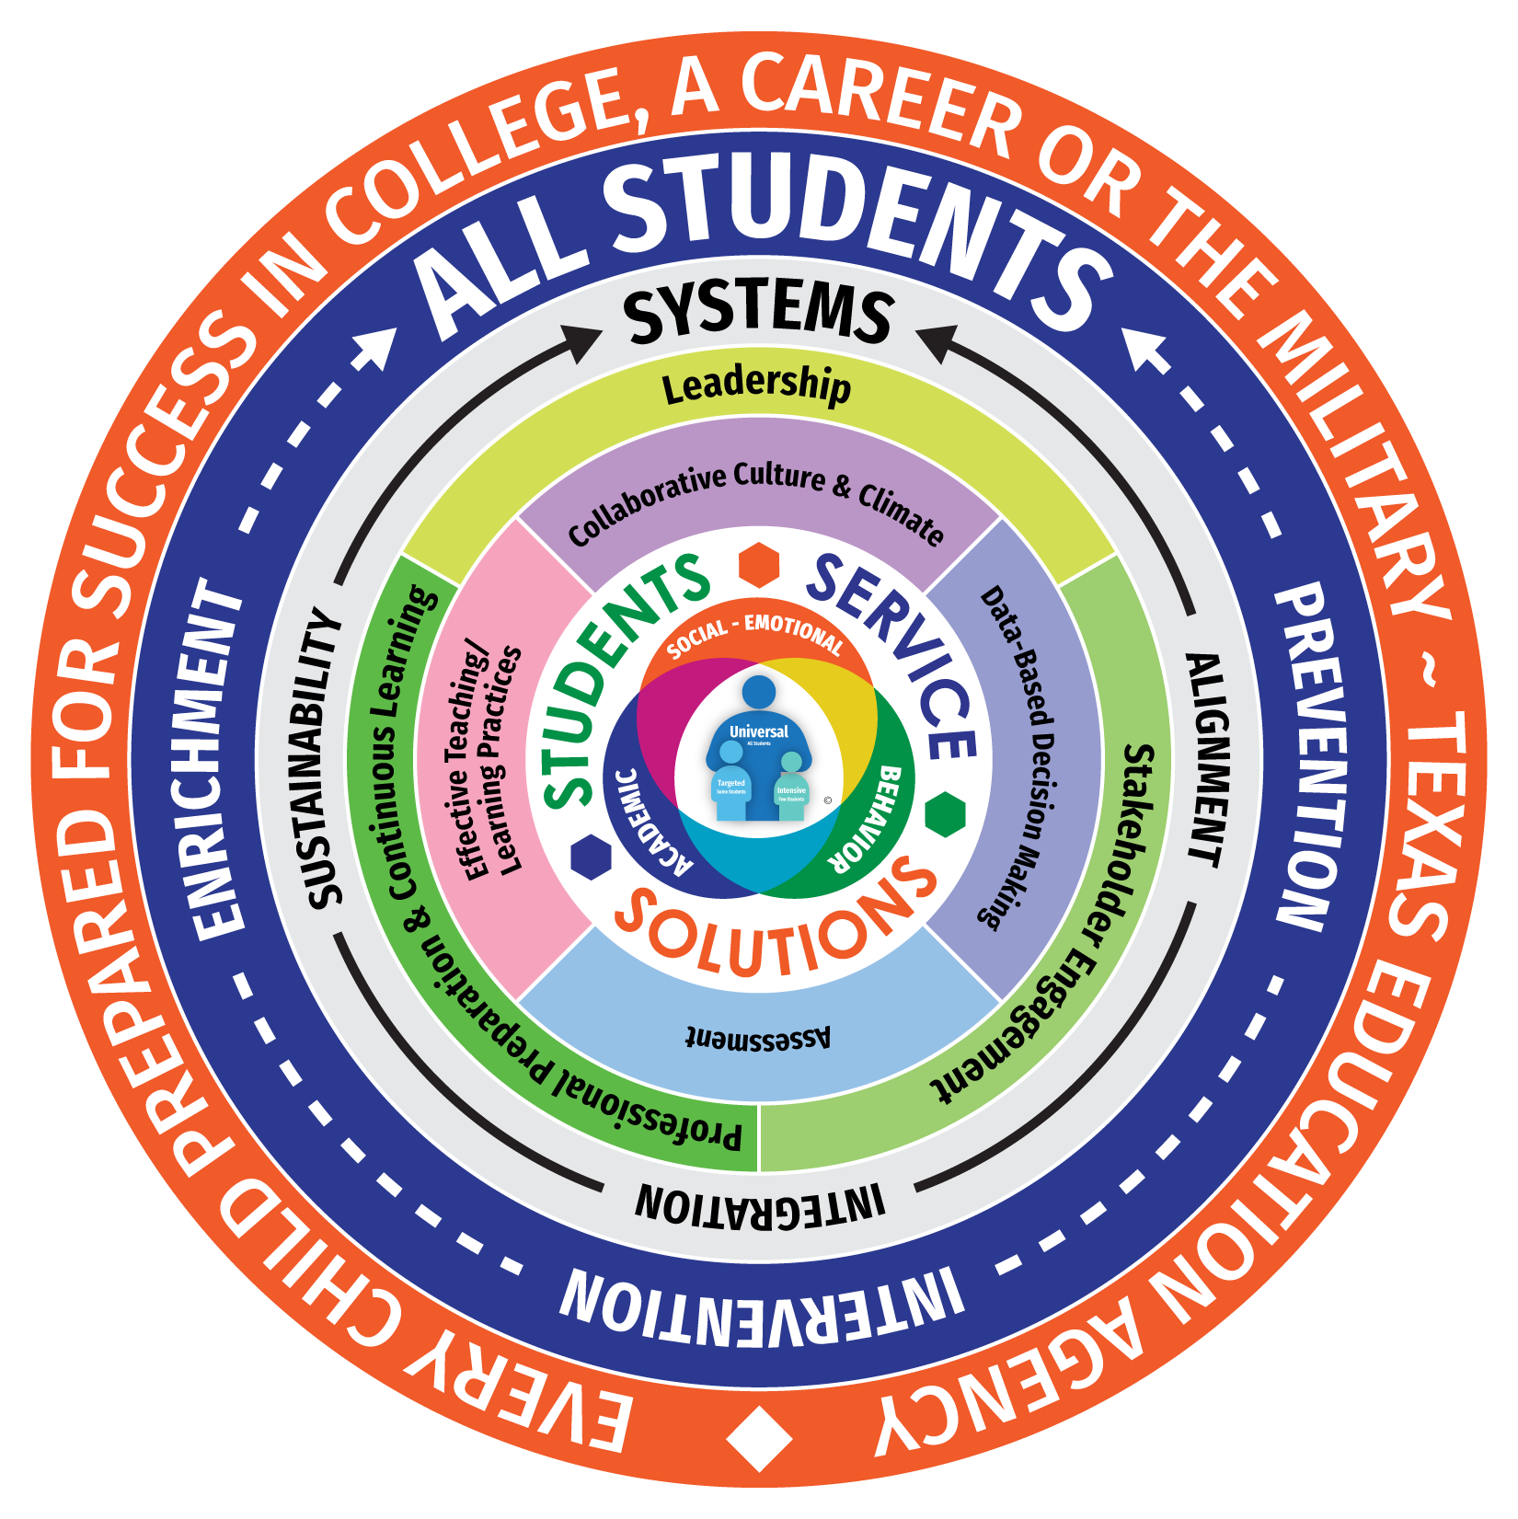
Multi-Tiered Systems of Support
OPTION 2 OF 3
Notes:
Guiding Principles MTSS is guided by the following principles:
• A collective responsibility for ensuring growth and success for all learners is assumed by each person within the system (educators, learners, families, and community)
• A proactive approach to ensuring that each and every learner experiences a quality education designed to expand learners' potenti
• A commitment to use data as a basis for information gathering and decision-making to avoid making assumptions
• Attention to fidelity of implementation, honoring both qualitative and quantitative measures
• An investment in systems to promote durability and the scaling up of MTSS
• A commitment to use a systematic problem-solving process to improve outcomes of all learners
• A commitment to ongoing, effective support for educators and leaders including professional learning, feedback, and coaching

Slide 10
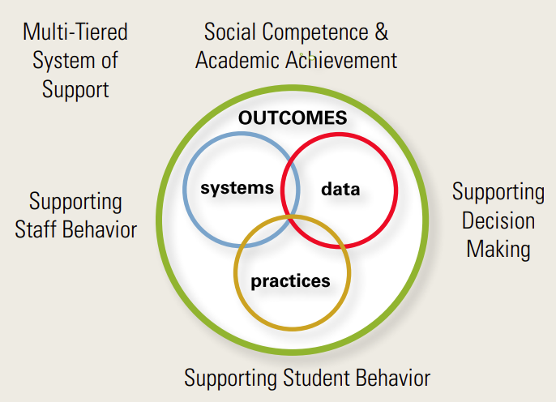
Multi-Tiered Systems of Support
OPTION 3 OF 3
Notes:
Guiding Principles MTSS is guided by the following principles:
• A collective responsibility for ensuring growth and success for all learners is assumed by each person within the system (educators, learners, families, and community)
• A proactive approach to ensuring that each and every learner experiences a quality education designed to expand learners' potenti
• A commitment to use data as a basis for information gathering and decision-making to avoid making assumptions
• Attention to fidelity of implementation, honoring both qualitative and quantitative measures
• An investment in systems to promote durability and the scaling up of MTSS
• A commitment to use a systematic problem-solving process to improve outcomes of all learners
• A commitment to ongoing, effective support for educators and leaders including professional learning, feedback, and coaching

Slide 11
The Key Elements of an Educational Experience
EXCELLENT EDUCATORS & INSTRUCTIONAL PRACTICES
EXCELLENT EDUCATORS & INSTRUCTIONAL PRACTICES
Vestibulum congue
Vestibulum congue
Vestibulum congue
STANDARDS, ASSESSMENTS & ACCOUNTABILITY
HIGH SCHOOL SUCCESS & POSTSECONDARY CONNECTIONS
EACH CHILD
EACH CHILD
STANDARDS, ASSESSMENTS & ACCOUNTABILITY
Vestibulum congue
Vestibulum congue
Vestibulum congue
Vestibulum congue
Vestibulum congue
Vestibulum congue
Vestibulum congue
STUDENT SUPPORTS & SCHOOL CLIMATE & CULTURE
EARLY LEARNING & LITERACY
Vestibulum congue
Vestibulum congue
Vestibulum congue
STUDENT SUPPORTS & SCHOOL CLIMATE & CULTURE

Slide 12
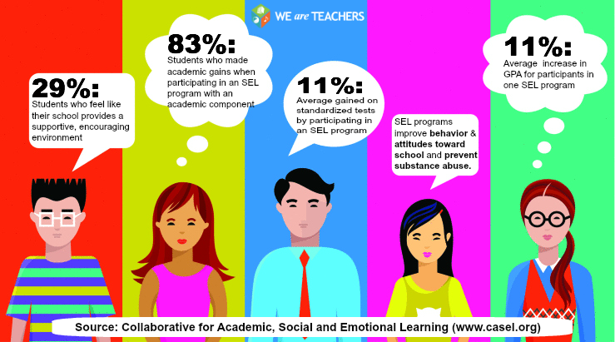
Why Does Social-Emotional Learning Matter?
What percent of students made academic gains when participating in an SEL program with an academic component?

Slide 13
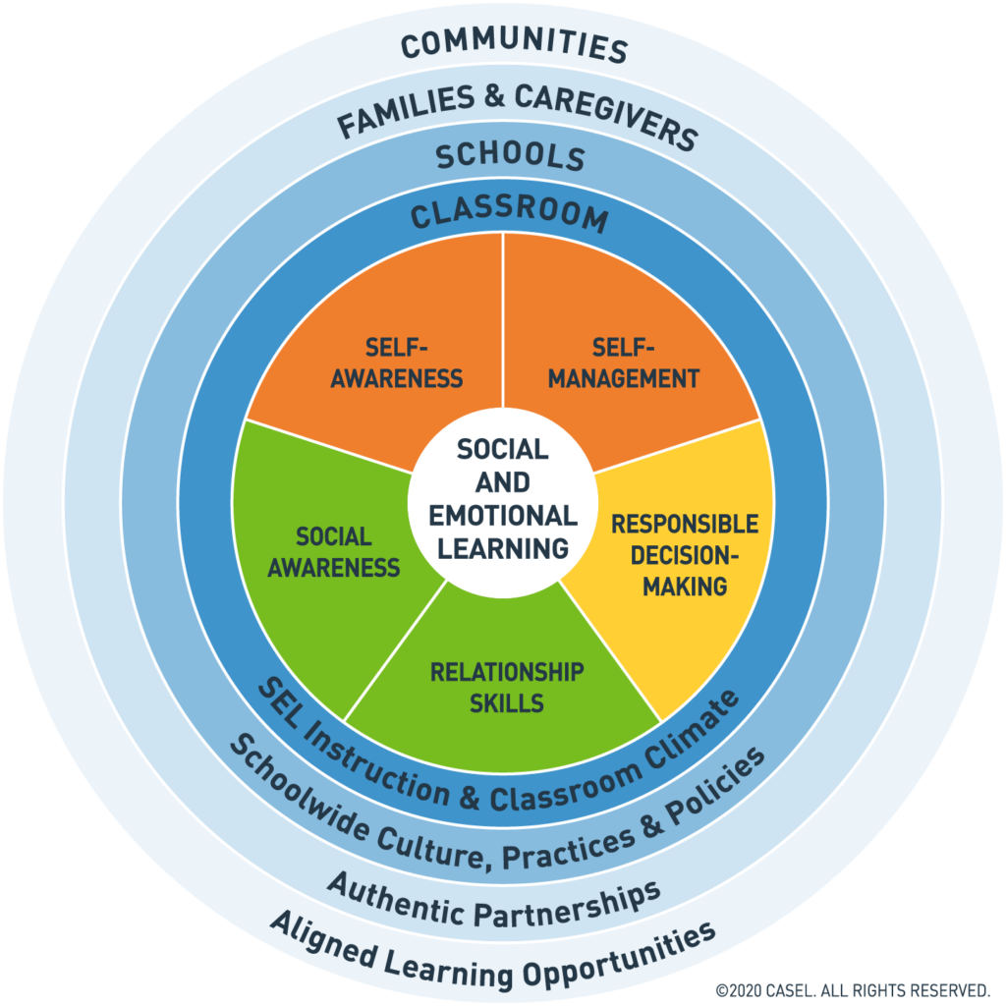
CASEL’s Updated Definition of Social & Emotional Learning
Social and emotional learning (SEL) is an integral part of education and human development. SEL is the process through which all young people and adults acquire and apply the knowledge, skills, and attitudes to develop healthy identities, manage emotions and achieve personal and collective goals, feel and show empathy for others, establish and maintain supportive relationships, and make responsible and caring decisions.
SEL advances educational equity and excellence through authentic school family-community partnerships to establish learning environments and experiences that feature trusting and collaborative relationships, rigorous and meaningful curriculum and instruction, and ongoing evaluation. SEL can help address various forms of inequity and empower young people and adults to co-create thriving schools and contribute to safe, healthy, and just communities.
Notes:
Exploring the new definition in full, here are the key additions:
Explicitly states how SEL can advance educational equity and excellence.
Elevates identity, agency, and belonging as critical pillars of SEL.
Acknowledges the positive impact that SEL can have on building just communities through collective goal setting and making caring decisions.
Emphasizes how environments, relationships, and broader contexts (e.g., societal realities, individual realities, socioeconomic status, family dynamics, cultural background, access to opportunities, and experiences in schools) shape learning and development.
The second paragraph, in particular, offers a more holistic view of where and how SEL occurs. This broadened scope allows for a more explicit inclusion of areas like family engagement, adult SEL, social justice, cultural competence, curriculum and instruction, continuous improvement, and equity.

Slide 14
What percent of restraints involved students with disabilities during the 2019 - 2020 academic school year?

Slide 15
78%
10,944 students with an Individualized Education Plan (IEP)

Slide 16
What percent of seclusions involved students with disabilities during the 2019 - 2020 academic school year?

Slide 17
80%
6,037 students with an Individualized Education Plan (IEP)

Slide 18
Restraint Rate of Students Without Disabilities
22%
3,064 students without an Individualized Education Plan (IEP)
Seclusion Rate of Students Without Disabilities
20%
1,523 students without an Individualized Education Plan (IEP)

Slide 19
Rule Ohio Revised Code 3301-35-15
Each School District shall implement PBIS on a system-wide basis.
#1
Notes:
Each school District shall implement PBIS on a system-wide basis
District implement requirements include:
A Decision Making Framework that guides selections, integration and implementation of evidenced based academic and behavior practices
The following integrated elements:
Data-based decision making (to select, monitor, and evaluate outcomes, practices, and systems)
Evidenced-based practices along a MTSS system
Systems that enable accurate and sustainable implementation of practices
Progress monitoring for fidelity and target outcomes
Standards for District Implementation
Student personnel to receive professional development
Explicit instruction of school-wide behavior expectations
Consistent systems of acknowledging and correcting behaviors
Teaching environments designed to eliminate triggers
Family and community involvement
Professional Development for student personnel to implement PBIS on a system-wide basis
Occurs at least every three years
Provided by building or district PBIS team or in collaboration with state/local/national source
The trained PBIS team will provide PD in accordance with the training plan. It is the district’s responsibility to retain records that such training occurred.
Professional Development will include the following topics:
An overview of PBIS
A Process for teaching behavioral expectations
Data Collections
Implementation of PBIS with fidelity
Consistent systems of feedback to students with acknowledgement and correction for errors
Consistency in discipline and discipline referrals
The District may accept any Professional Development as long as it meets the requirements of this rule.
Districts and schools are to ensure that they have continuous training structures in place to provide ongoing coaching and implementation with fidelity.

Slide 20
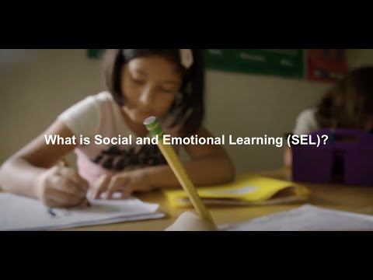
Notes:
Cathy - play video #2
https://www.youtube.com/watch?v=ouXhi_CfBVg
https://www.youtube.com/watch?v=Y-XNp3h3h4A

Slide 21
Social Emotional Learning
Trauma-Sensitive Practices
Commitment
Protective Factors & Relationships
Create Safe Environments
Adult Trauma / Self-Care
Supportive Strategies
Self-Care Spaces
Needs Survey - Trauma-Informed School Questionnaire (TISQ)
Fidgets / Self-Calming
Mindfulness
Resilience Building
Compliance
SEL Standards
Self-Awareness
Self-Management
Social Awareness
Relationship Skills
Responsible Decision-Making
Notes:
Experiencing trauma does not automatically mean there will be significant impacts. TI approaches incorporate a strengths based approach
Relationships- most influential positive factor- supportive, healthy relationship with a trusted adult
Safe environ- predictable...PBIS Tier 1 practice of teaching bx expectations
Adult trauma- Practicing self-care- break room set up with items to support each other emotionally
Supportive Strategies- PD, TISQ- Trauma Informed School Questionnaire- measures your school staff members’ perceptions of the frequency to which they individually, and the school collectively, exhibit trauma-informed, resilience-focused knowledge and behaviors; fidgets/self-calming strategies- Calm Kit-teach and practice; mindfulness- deep breathing, yoga; resilience building- done for everyone- can be based on themes and age appropriateness

Slide 22
How to Support Those in Crisis
National Suicide Prevention Lifeline
800-273-8255
Crisis Text Line: Mental Health First Aid
741-741
Trevor Project: LGBTQ Youth
866-488-7386

Slide 23
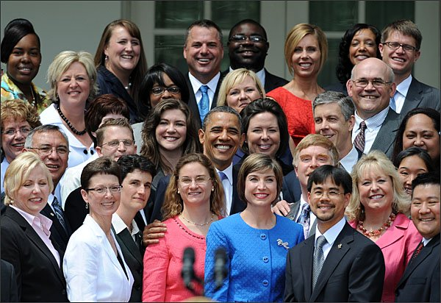
Supporting Those That Support Our Students
The Impact of Caring:
“The expectation that we can be immersed in suffering and loss daily and not be touched by it is as unrealistic as expecting to be able to walk through water without getting wet.”
Rachel Noomi Remen, MD
Notes:
As administrators we need to support our staff

Slide 24
Recognize Warning Signs
Burnout occurs when there is a problem of the social environment in which they work. Feeling of frustration, powerlessness, constraints, unable to achieve work goals.
Compassion Fatigue ‘just being tired of caring’. A mental, physical and emotional state of exhaustion. Results in errors in judgment, detachment, and a restricted range of affect.
Vicarious Trauma happens slowly over time and transforms our inner experience and changes our world views.
Example:
“Why don’t they get it? They all cheat. They don’t care.”
Notes:
Vicarious trauma example- great niece, age 7, neighborhood girls went to a friends house to play and a group of older boys asked if they could play too. What is the first question you would ask my great niece?
Develop a response list link
One minute

Slide 25
Embrace Resiliency
& Celebrate
Compassion Satisfaction The pleasure you receive from teaching in small ways (lightbulb moments) and big ways (learning to read).
Vicarious Resilience
Change in your worldview
Example: “I am grateful.”
“My students teach me something each day.”
“Most try their best.”
“The opposite of play is not work, it is depression.” ~ Miranda Chapman

Slide 26
“Humans seek CONNECTION above all else, and we are willing to DESTROY things to attain it!”
~ Tarryn Fisher

Slide 27
Restorative Practices
Social Emotional Learning (SEL) is critical for both students & adults when working toward building community, resolving conflict, & repairing harm...all of which are ESSENTIAL elements of Restorative Practices (RP)!
With relationships & community at the HEART of RP, implementation of this approach provides multiple opportunities to develop, practice, & reinforce all five SEL competencies
Notes:
SEL is critical for both students & adults when working toward building community, resolving conflict, & repairing harm - all of which are essential elements of RP. With relationships & community at the heart of RP, implementation of this approach provides multiple opportunities to develop, practice, & reinforce all five SEL competencies:
Self-Awareness & Management, Social Awareness, Relationship Skills, & Responsible Decision-Making.
meets the required aspects of the Social-Emotional Learning (SEL) Domain as outlined within the Ohio Department of Education "#Each Child, Our Future" strategic plan.

Slide 28
Restorative Practices
Restorative Practices is an emerging social science that studies how to strengthen relationships between individuals as well as develop social connections within communities.

Slide 29
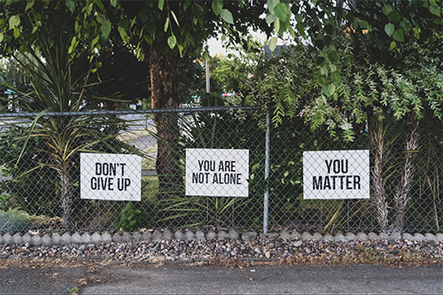
Today... In Review!
Vision to Support the Whole Child
Barriers We Will Overcome
Learned and Practiced Strategies with Coaching Supports
Notes:
Today, we addressed several items as they relate to: BEHAVIOR!
Refreshed your understanding of Each Child, One Future…. Specifically the Social Emotional Learning Domain and the strategy of meeting the needs of the Whole Child
Provided supports to address BEHAVIOR

Slide 30
Will this be easy? No, but it can be done. We are never to old to learn, we are never too meek to lead, and we are never too tired to try again when others’ welfare is the goal. This is not the time for fear, rather courage.
Jeff Grimes (Personal Communication, 2005)

Slide 31
Thanks!
Any questions?

